Slide 1


Analyzing User Interactions with Microsoft Clarity
Research Work By : Anamika Tiwary

Slide 2




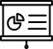
Research Objectives and My Plan
The Objective of the Research Work was to Analyze User Interactions with Microsoft Clarity
I devised my plan according to the number of days and allocated work for each day, which is menntioned below :
DAY 1
DAY 2
DAY 3
DAY 4
Read through the documentation of Microsoft Clarity and watched Youtube Videos.
Set Up the Website on Clarity And did some more research on Clarity.
Analyzed the Website and Started with the Presentation.
Completed the research work and done with the presentation.

Slide 3

Introduction
In today's digital landscape, understanding user behavior is crucial for optimizing website and application performance. Microsoft Clarity offers a powerful solution for analyzing user interactions, providing valuable insights that can inform strategic decisions and enhance user experience.
Microsoft Clarity is a comprehensive analytics tool that enables website and application owners to gain deep insights into user behavior. It offers a range of features and functionalities designed to track and analyze user interactions in real-time, providing actionable data for improving website performance and user engagement.

Slide 4

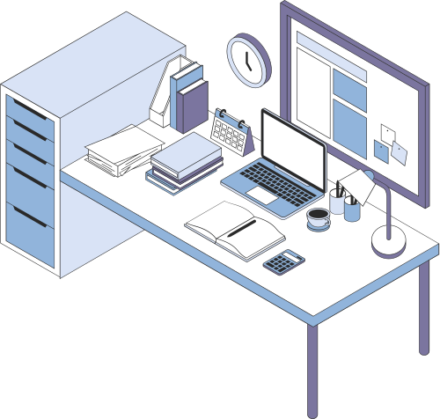


Setup and Installation
Sign Up or Sign In
Create a New Project
GenerateTracking Code
Add Tracking Code to the Website
Verify Installation
Configure Settings (Optional)
Start to Analyze User Interactions

Slide 5






Session Playback
Heatmaps
Key Features of Microsoft Clarity
Click & Scroll Tracking
Allows replaying user sessions to visually understand how users interact with the website or application.
Visualizes user engagement by highlighting areas of the website or application that receive the most attention.
Tracks user clicks and scrolls in real-time to identify the most engaging elements.
Insights Dashboard
Conversion Analysis
Real-time Data
Provides an intuitive dashboard for viewing key metrics and insights at a glance.
Helps in analyzing user behavior to identify conversion bottlenecks and optimize marketing strategies.
Provides real-time data on user interactions, allowing for quick adjustments and optimizations.

Slide 6


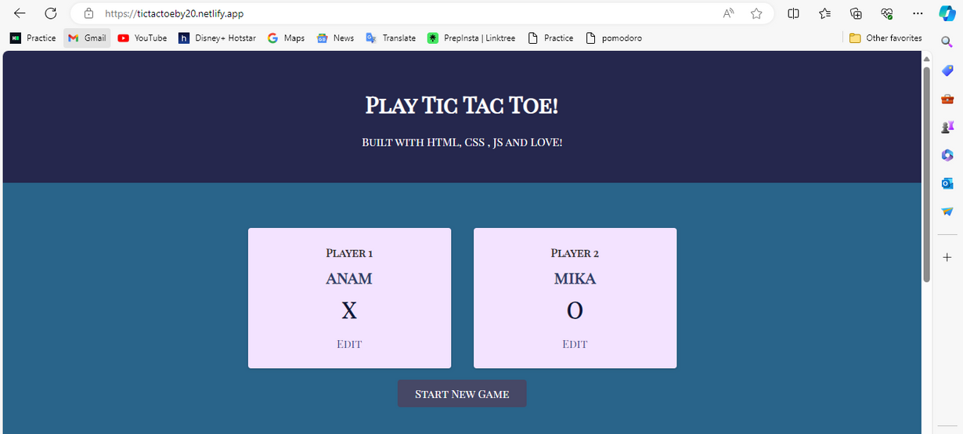
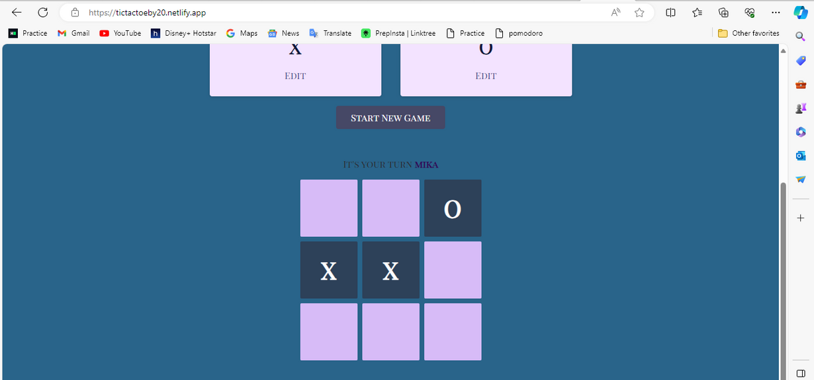
Use of Microsoft Clarity in my Website
Site Link
I built this site when I was in 2nd Year of College using pure HTML, CSS & JS and conducted the Microsoft Clarity Reasearch Work on it!
Following is my analysis of the same

Slide 7
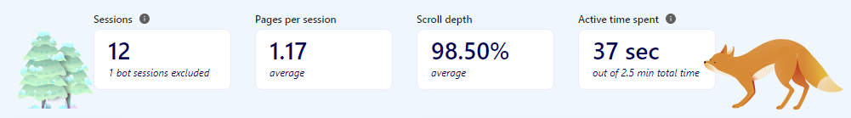
Analysis
Sessions:
There have been a total of 12 sessions in the past week, with 1 bot session excluded. This indicates the number of times users have visited my website.
Pages per Session:
The average number of pages viewed per session is 1.17. Since there is only one page.
Scroll Depth:
The average scroll depth is 98.50%, indicating that users are scrolling almost to the bottom of the page on average.
Active Time Spent:
The average active time spent on the website is 37 seconds out of a total time of 2.5 minutes. This suggests that while users are spending a significant portion of their time on the website, they may not be actively engaging with it for the entire duration.

Slide 8

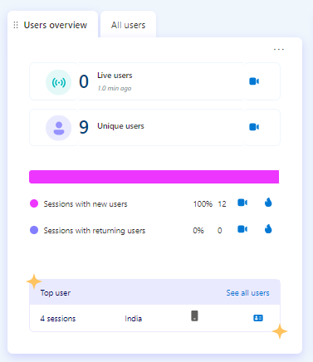
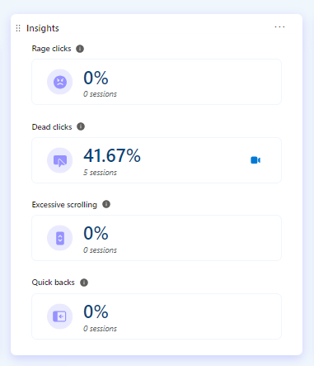
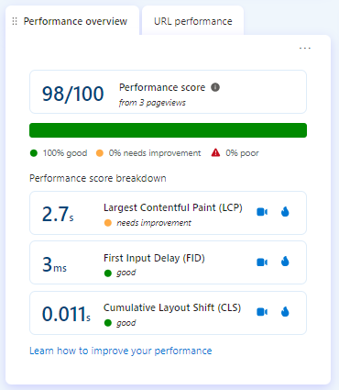
Analysis
Users Overview & Top User:
Insights:
Performance Overview:
There have been 9 unique users in the past week, with the most recent live user active 7.7 minutes ago. All sessions have been with new users, indicating no returning users within this timeframe.
The user with the most sessions is located in India, with 4 sessions.
There have been no rage clicks recorded.
Dead clicks have been recorded in 41.67% of sessions, indicating instances where users clicked on elements that did not result in any action or response.
There have been no instances of excessive scrolling or quick backs.
The website's performance score is 98 out of 100, indicating good performance overall.
The breakdown shows that the Largest Contentful Paint (LCP) needs improvement, while the First Input Delay (FID) and Cumulative Layout Shift (CLS) are good.

Slide 9

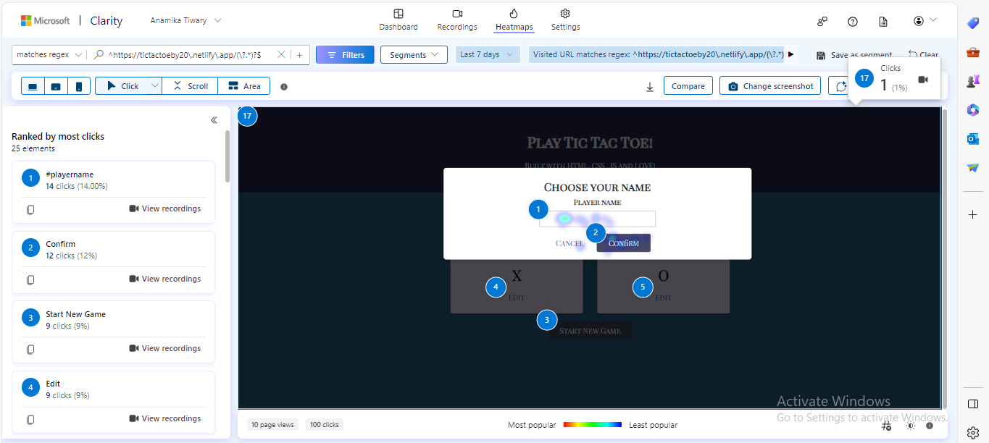
Heatmaps
These are the summarized results of the Heatmaps:
Users on desktop devices scrolled through the entire page and viewed all the content, with an average fold of 661 pixels.
Users on desktop devices clicked on the Edit button more than any other element, followed by the Start New Game button and the Player Name input field.
Users on mobile devices also scrolled through the entire page, with an average fold of 735 pixels, but some of them dropped off at the 90% and 95% scroll depths.
Users on mobile devices clicked mostly on the Start New Game button and the X symbol, as well as some dead clicks on the Player Name input field and the O symbol.
There is no data for tablet devices, suggesting that the page is not optimized or marketed for this device type.

Slide 10
CONCLUSION
Based on my findings, I have drawn some inferences that needs to be done to improve the perfomance of the page and give users a good experience:
Optimize Page Load Time
Improve Game Experience
I will need to address any issues identified with the Largest Contentful Paint (LCP) metric to improve loading times.
To showcase the game features and instructions, my website could use a modal window, a video, or a carousel, instead of a long text section that users have to scroll through.
Fix Dead Clicks
Improve User Engagement
As my page had 41% dead clicks, I need to identify and fix any non-functional buttons that are leading to dead clicks by conducting thorough testing
To improve the user experience and engagement, my website could use more interactive and responsive elements, such as animations, feedback messages, and sound effects.

Slide 11


